Slide 1


Green Pace
Security Policy Presentation
Developer: Austin Moore
Notes:
Hello Everyone, my name is Austin Moore and today I will be covering our security policy for the Green Pace company.

Slide 2

OVERVIEW: DEFENSE IN DEPTH
In order to standardize principles and coding standards for all employees here at Green Pace, we are implementing this new security policy. Utilizing practice such as DiD and Triple-A Framework we will be using the best security practices.
Notes:
I’m sure some of you may be wondering what defense in depth is. Defense in depth is the practice of implementing multiple layers of security in order to protect one’s assets. There are many different kinds of layers that can be implemented such as: following best coding practices, firewalls, secure gateways, two-factor authentication, principle of least privilege, antivirus software and so on. By implementing multiple layers of security you are creating an overlapping net that prevents any unauthorized access though an individual layer, helping to keep your applications more secure. This also helps to protect the system when there has already been a breach as it can stop or limit the amount of access someone gains after breaching one of the layers.

Slide 3
THREATS MATRIX
Likely STD-003-CPP STD-004-CPP STD-005-CPP STD-007-CPP STD-008-CPP | Priority STD-002-CPP STD-003-CPP STD-004-CPP STD-005-CPP STD-008-CPP STD-009-CPP STD-010-CPP
Low Priority STD-006-CPP STD-009-CPP | Unlikely STD-001-CPP STD-006-CPP STD-009-CPP
Notes:
The threat matrix is used to show how the severity level for each of the coding standards is assessed. These threats are detected using a static analysis test which then also offers suggestions on how to fix these corrections, or you can look them up and find ways to correct them. It’s best to use multiple static analysis tools as not all of these errors will be detected by each one and they may offer different kinds of ratings and likelihoods for different corrections. As you can see from our standards we have 3, 4, 5 and 8 all being likely to lead to vulnerabilities as well as having a high relevance which means these should be the priority fixes that take place immediately. Though we have a few with low priority or some that are unlikely that doesn’t mean they are fine and we should leave them, they are just lower on the priority list for fixing as they can still lead to vulnerabilities in the system.

Slide 4
10 PRINCIPLES
Validate Input Data
STD-001-CPP | STD-002-CPP | STD-003-CPP |STD-004-CPP | STD-010-CPP
Heed Compiler Warnings
STD-001-CPP | STD-005-CPP | STD-007-CPP
Architect & Design Security Policies
STD-004-CPP | STD-007-CPP | STD-009-CPP
Keep It Simple!
STD-001-CPP | STD-009-CPP
Default Deny
Principle of Least Privilege
STD-005-CPP
Sanitize Data
STD-004-CPP | STD-005-CPP
Defense in Depth
Quality Assurance Techniques
STD-001-CPP | STD-002-CPP |STD-003-CPP | STD-005-CPP
Secure Coding Standard
STD-001-CPP | STD-002-CPP | STD-003-CPP | STD-004-CPP | STD-005-CPP
STD-007-CPP | STD-009-CPP | STD-010-CPP
Notes:
Here you can see our 10 Principles and the coding standards that apply to them, there is some overlap as each standards is not going to fall under just one principle. We also have a few principles where none of the standards fall into, this is because we only have 10 standards right now and there are literally hundreds of standards total.
For Validate Input Date we have: 001, 002, 003, 004, 010
For Heed Compiler Warnings: 001, 005, 007
Architect & Design Security Policies: 004, 007, 009
Keep It Simple: 001, 009
Default Deny: we have none
Principle of Least Privilege: 005
Sanitize Data: 004, 005
Defense in Depth: we have none again
Quality Assurance Techniques: 001, 002, 003, 005
And for Secure Coding Standards we have: 001, 002, 003, 004, 005, 007, 009, 010

Slide 5
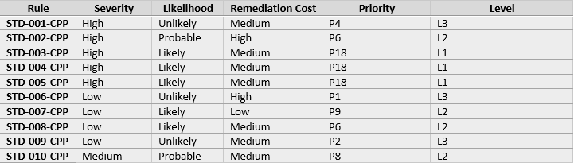
CODING STANDARDS
Notes:
Here we have the 10 coding standards that were selected along with their severity, likelihood, remediation cost, priority and level. As the rules have basic labels I will tell you what they relate to.
Rule 1: Is for Data Type and the standard is to not cast an out of range enumeration value
Rule 2: Is for Data Value and the standard is to use valid references, pointers & iterators to reference elements of a container
Rule 3: Is for String Correctness and the standard is to not attempt to create a std string from a null pointer
Rule 4: Is for SQL Injection and the standard is to not store already owned pointer values in an unrelated smart pointer
Rule 5: Is for Memory Protection and the standard is to properly deallocate dynamically allocated resources
Rule 6: Is for Assertions and the standard is to use a static assertion to test the value of a constant expression
Rule 7: Is for Exceptions and the standard is to handle all exceptions thrown before main begins executing
Rule 8: Is for Input Output and the standard is to not alternate input and output from a file stream without intervening positioning calls
Rule 9: Is for Object Oriented Programming and the standard is to not invoke virtual functions from constructors or destructors
Rule 10: Falls under Miscellaneous and the standard is that value returning functions must return a value from all exit paths

Slide 6
ENCRYPTION POLICIES
Encryption in rest
Securely encoding data as it is written to storage
Decrypting data when it is pulled from storage
Protects data from unauthorized access (even if someone gets into the system)
Encryption at flight
Securely encoding data as it is being transmitted
Multiple different forms depending on how data is being transmitted
Encryption in use
Process of protecting data as it is utilized in memory
Multiple different forms depending on the circumstances of the data
Think of multiple personal profiles on the same computer where data is not shared between users
Notes:
Encryption is important as it prevents unauthorized access to data. There are three forms of data, data at rest which is data that is being stored, data at flight which is data that is being transmitted and data in use which is data that is currently being utilized in memory. It’s important to protect data in all of these forms so that it cannot be stolen or accessed by people with malicious intents.
For encryption at rest we will implement strategies to: (read slide)
For encryption at flight we will: (read slide) examples of the different forms would be managed file transfer, SHH, password access + 2FA
For encryption in use we will: (read slide) this can easily be done by utilizing identity management along with assigned roles to allow/deny access based on privileges.

Slide 7
TRIPLE-A POLICIES
Authentication
Who is the user accessing the system
Authorization
What can the user do inside the system
Accounting
What was the user doing and when were they doing it
Notes:
The triple A policy covers Authentication, Authorization and Accounting.
Authentication is the process of identifying who is accessing the system, this is typically done through the use of validating user credentials like a username and password. This can be improved further with the addition of two factor authentication as well as things like checking the IP address of the user trying to log in, or in extreme security cases verifying hardware on the system the user is trying to gain access on.
Authorization takes place after the user successfully made it through the authentication process. With authorization you determine what the user can do and what the user has access to inside of the system. For instance you can give a user privileges for read and write but only within certain files. You can also block users entirely from being able to access certain information like customer information, the general rule here is to give the bare minimum requirements to the user they need to get their job done.
Accounting is essentially monitoring and creating logs for any interactions the user has while they are inside the system. Your log would looks something like:
User blank has logged in with a time stamp
User pulled up blank file with times stamp
user edited line 327 with time stamp
User saved blank file with time stamp
User was denied access to blank file with time stamp.
This process can help you keep track of and notice when someone with malicious intent has gotten into the system, or if someone within the company is doing things they should not be doing.

Slide 8
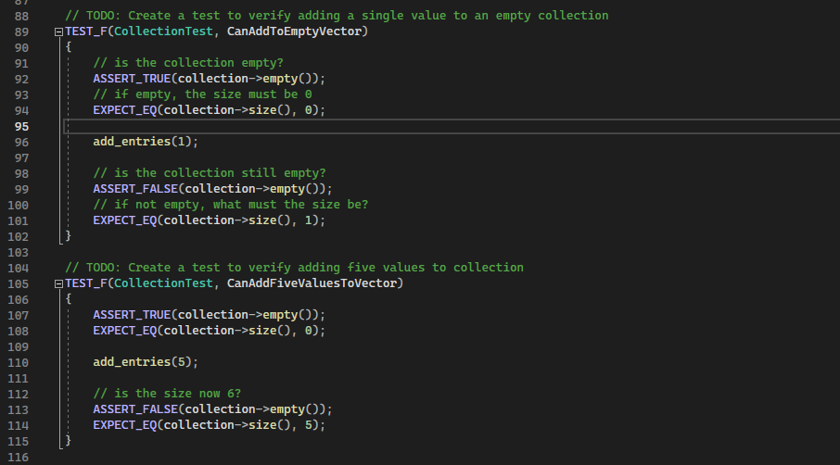
Unit Testing
Notes:
Unit Testing is the process of creating tests that are used to verify the functionality of your application and ensure it is working properly. Here we have an example of two tests, one to verify the addition of a single value to an empty collection. You can see we first very the collection is empty, then if empty the size must be 0 we then add 1 entry and now we ensure the collection is not empty followed by ensuring the size is 1. The test below that is similar to the first but this time we add 5 entries and make sure the collection size is then 5.

Slide 9
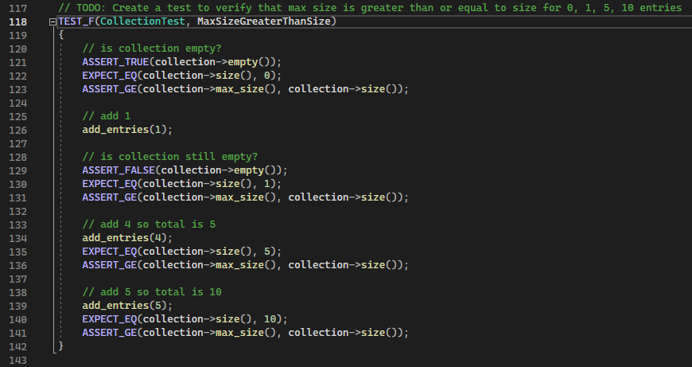
Unit Testing
Notes:
This unit test example follows a similar pattern of the first one, but here we are checking multiple different entries in a single test, starting with 0 entries, then adding 1 and checking to make sure the size is correct, we then add an additional 4 and verify the size is now 5, then we add 5 more and verify the size is 10. If at any point one of these checks of size is not correct then the entire test will fail.

Slide 10
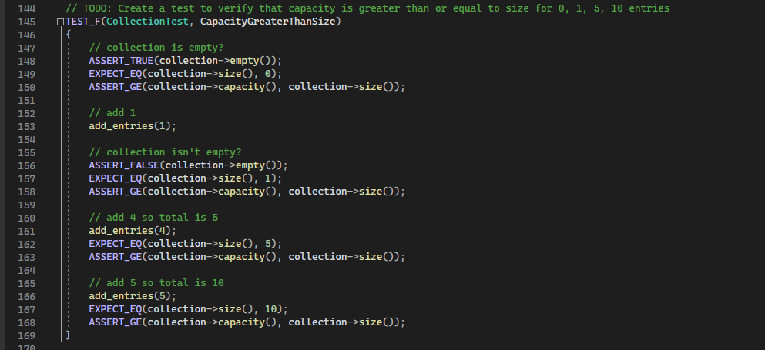
Unit Testing
Notes:
For this unit test we are doing something similar to the last one, however now instead of confirming that the size of the collection is correct we are ensuring that the capacity for the collection is greater than or equal to the size. This is important as if our capacity is 9 but our size is 10 then the 10th entry will not actually be there as the collection only holds 9 entries.

Slide 11
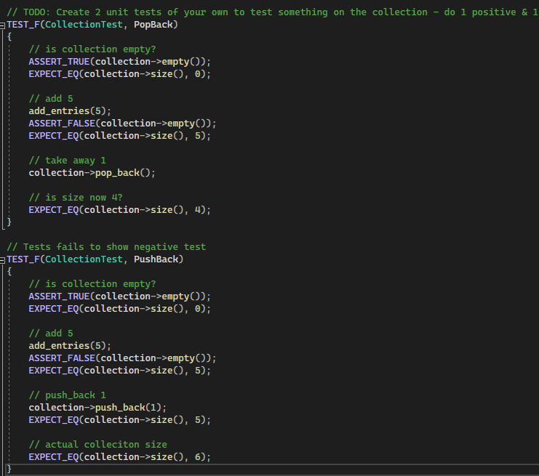
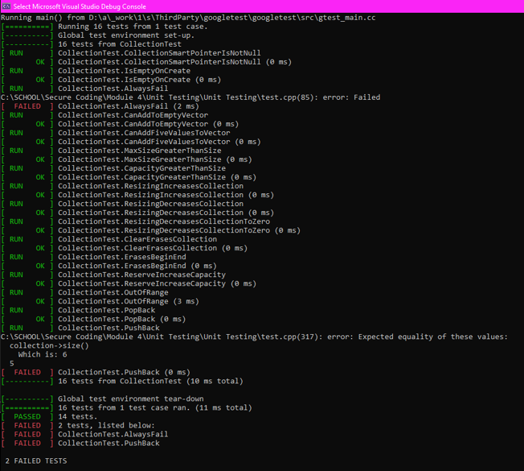
Unit Testing
Notes:
Here we have an example on the left of two tests I created, a PopBack and a PushBack within a collection that contains multiple entries. The PopBack test was created to function successfully, adding 5 entries to the collection and then using a popback so there is only 4 entries and then ensuring that only 4 exist. The pushback test was created to fail by adding 5 entries to the collection then using a pushback to add a 6th entry but we first look to ensure there are 5 entries which causes the test to fail as there are actually 6. You can see the output from all of the unit tests over on the right hand side, the pushback and popback are the last two tests that were ran. As you can see the 3rd test is also set up to always fail, this can be a good practice as well to make sure that certain things cannot be done within your application that you don’t want to take place.

Slide 12

AUTOMATION SUMMARY
Notes:
This visualization of the pipeline for devsecops shows how automation can be introduced into the software development lifecycle. As you can see security had been brought to the forefront of every phase. If we follow through we see we start with assessing and planning, this means what kind of threats might we have to deal with, what kind of information will we have that people want access to and what kind of damage can be done is someone does get in. Then we move on into designing and building the system utilizing testing often, following best practices and securing the system. Once the system is build we need to heavily test the entire system to make sure it is full proof. Then it can be pushed into production where once again we will need to ensure security and continue to penetration test the system. We need to keep data logs and have system implemented to notify us when breaches do occur or suspicious activity is taking place. These then need to be dealt with immediately to prevent anyone else utilizing the same exploits and to prevent any information being stolen. We then need to maintain and stabilize the system, ensuring that everything is now secure again and then repeat as it is a cycle.

Slide 13
TOOLS
DevOps is focused on security protocols from the start to the end.
Design
Building
Testing
Production
Maintenance
A Variety of tools are utilized throughout the DevOps process
Clang
Astree
CPPCheck
Unit Tests
Notes:
DevSecOps is an acronym for Development, Security and Operations – its main focus is to integrate security into every phase of the SDC (software development lifecycle) by utilizing automation tools. These security protocols need to be implemented into all aspects of the lifecycle including design, building, testing, production and maintenance.
Some of the tools that were used to run the testing for Green Pace were Clang, Astree CPPCheck and Unit Tests. CPPCheck is a static analysis testing application which is used to detect warnings and errors in the code that has been written, it then includes a description, error that it can cause and suggestions on how to fix each one. The unit testing was done using Google Test as it’s quite simple to use and it integrates into the IDE.

Slide 14
RISKS AND BENEFITS
Wait to Implement
Upfront Cost and Effort are Lower
Won’t Break Current Production Cycle
More Difficult to Manage and Implement Later
Implement Now
Upfront Cost and Effort are Higher
Security Becomes a Priority from the Start
Less Risks When Put Into Production
Easier to Manage in the Long Run
Won’t Have to go Back and Fix Bad Coding Practices Later
Notes:
When deciding to adopt a new workflow there are always going to be risks and benefits, currently for green pace is migrating to DevSecOps the risks are going to include:
More upfront cost and more effort.
The employees who are currently working are going to need additional training as they are not familiar with the new workflow.
The production cycle will be broken as we will have to go back and start implementing security measures from the start.
The benefits of making these changes now instead of waiting are that security will be a priority which will help to ensure the application is built and protected properly. When sending the application to development there will be a lot less risks, over time the application will be easier to manage since best coding procedures and security implementations have been done. You will not have to go back later through even more work that has been done improperly.

Slide 15
RECOMMENDATIONS
Unit Testing
Encrypt All Data
Follow Triple-A Framework
Only Collect Needed Data
Get Rid of Data Not Being Used
Utilize External Tools for Vulnerability Checks
Notes:
Unit testing is something that can be implemented fairly easily, I think that utilizing secure coding practices and implementing unit testing would be a good way to slowly start to introduce the DevSecOps pipeline to the SDC for green pace. Also utilizing things like CPPCheck does not take much time and the developers will learn from it as they go which will help to save them time in the future as they hopefully won’t continuously repeat the same mistakes. GreenPace also needs to follow the Triple-A Framework to ensure access is limited not only when a malicious attack happens but also with their employees because not everyone needs access to all the data. Implementing the three forms of data encryption we talked about earlier will help to reduce the risk that any data is stolen, which can save green pace a lot of money and bad publicity by preventing large data leaks. Massively important as well is to get rid of the data not being used, this way if a major breach does happen you are not giving away extra data/information that you didn’t need to be holding onto in the first place as this can get you into even more trouble.

Slide 16
CONCLUSIONS
Implement Defense in Depth
Don’t Leave Security Until the End
Test Thoroughly and Often
Use Best Coding Practices
Notes:
To wrap things up do not underestimate how important it is to implement Defense in Depth and to have a design for security before you even start creating a project. Not only will it save you time down the road but it will also save you money in the long run and help to protect your business, employees and users. If you wait until your project is almost finished you are going to hit a massive wall where your engineers are going to have to go back through and try to fix hundreds of errors, or if you go to production anyway before making corrections then you risk bad publicity, fines and the potential of being shut down. Make sure that throughout the software development lifecycle you are testing everything you do thoroughly and often, you don’t want to waste time by testing too often but it’s better to test too often then not often enough. Also be sure to use best coding practices, if you don’t know what they are then it’s time to do some of your own research and start implementing these principles into your code.

